Slide 1
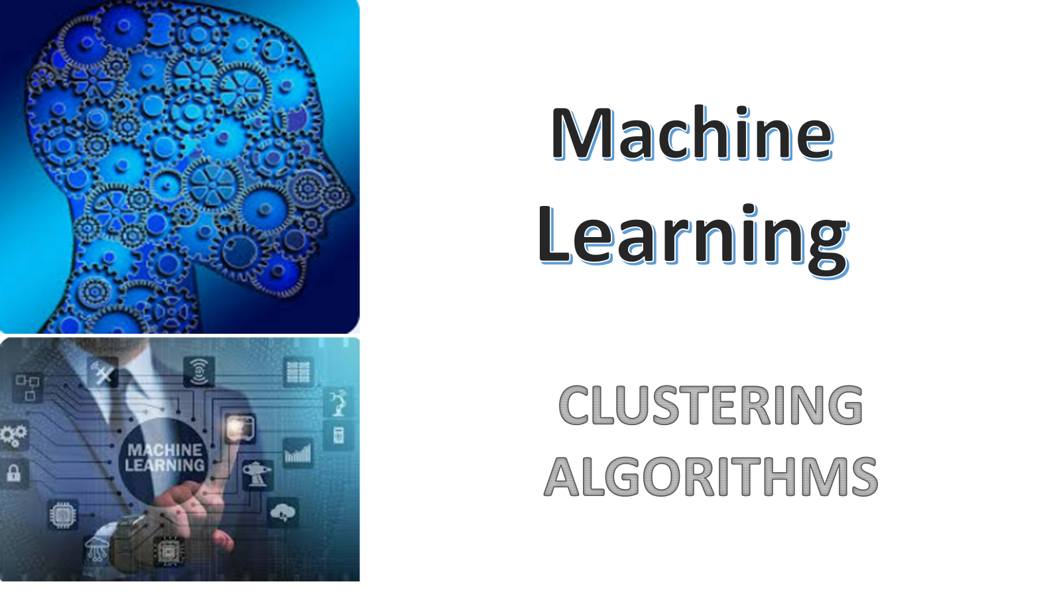

Slide 2
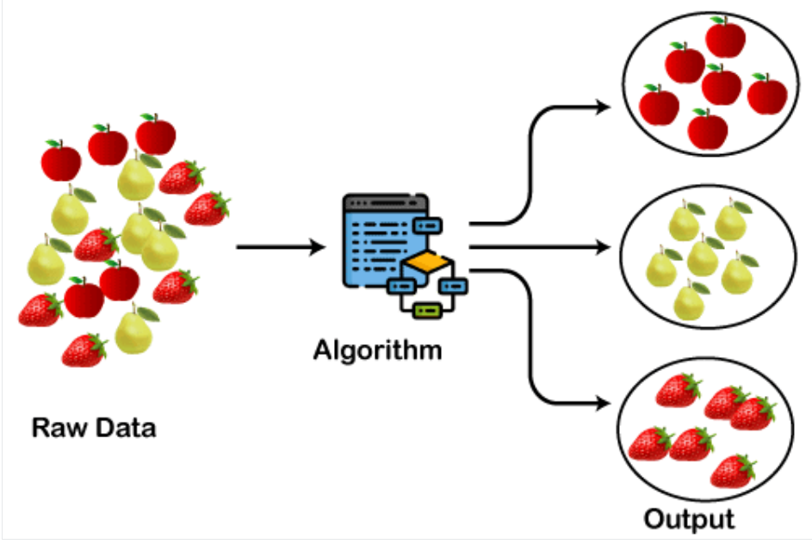
CLUSTERING
Clustering is a machine learning technique used to group a set of objects into clusters based on their similarities. Each cluster contains objects that are more similar to each other than to those in other clusters. It’s an unsupervised learning method, meaning it doesn't require labeled data. Common algorithms for clustering include K-means and hierarchical clustering. Clustering is widely used in data analysis, pattern recognition, and image segmentation.

Slide 3
Types of Clustering
1. K-Means
2. Hierarchical Clustering
3. DBSCAN
4. OPTICS
5. BisectingKMeans
6. Mean Shift
7. spectral clustering
8. Affinity propagation
9. HDBSCAN
10. Birch clustering

Slide 4
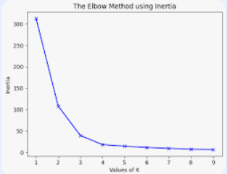
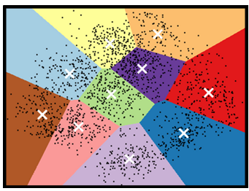
K-Means
Definition:
K-Means clustering is an unsupervised machine learning algorithm that partitions a dataset into K distinct, non-overlapping clusters based on the similarities between data points.
Basic Concept:
The goal of K-Means is to group data points into clusters such that points within a cluster are more similar to each other than to points in other clusters. This similarity is usually measured using Euclidean distance.(The Elbow Method)
Working Principle: Initialize: Randomly select K centroids, one for each cluster. Assign: Assign each data point to the nearest centroid, forming K clusters. Update: Recalculate the centroids as the average of all data points in each cluster. Repeat: Repeat the assign and update steps until the centroids no longer change significantly or a maximum number of iterations is reached.

Slide 5
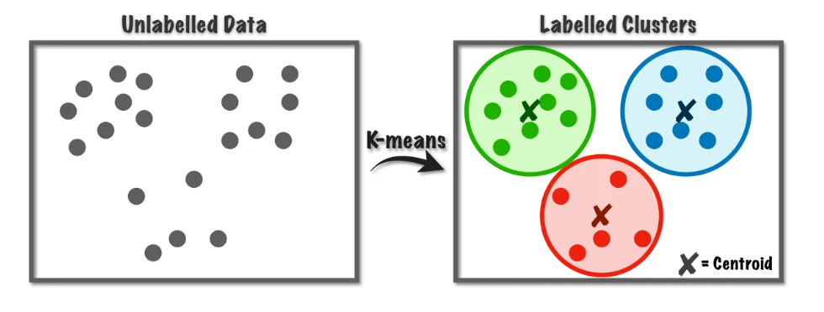
K-Means Clustering

Slide 6
Advantages:
Simple and Efficient: Easy to understand and implement, and works well on large datasets.
Scalability: Can handle large amounts of data efficiently.
Convergence: Generally converges quickly to a solution.
Disadvantages:
Choosing K: The number of clusters (K) must be specified in advance, which may require. trial and error
Sensitive to Initialization: Results can vary based on the initial placement of centroids.
Not Suitable for All Data: Struggles with clusters of varying sizes and densities, and is sensitive to outliers.

Slide 7
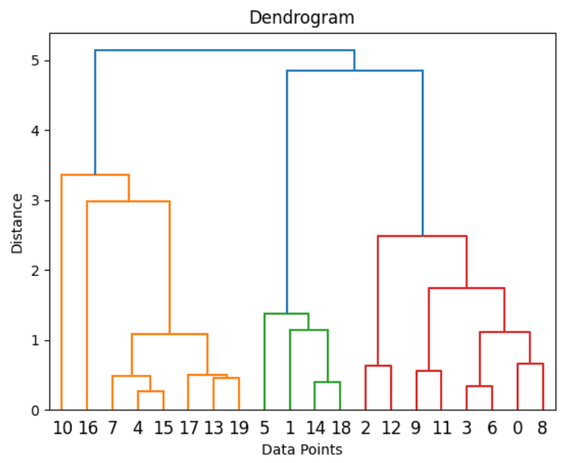
Hierarchical Clustering
Definition:
Hierarchical clustering is a method of cluster analysis that seeks to build a hierarchy of clusters. It is an unsupervised learning technique that doesn't require specifying the number of clusters in advance.
Basic Concept:
Hierarchical clustering creates a tree-like structure (called a dendrogram) that visually represents the nested grouping of similar objects. There are two main types of hierarchical clustering:
Agglomerative (Bottom-Up): Starts with each data point as its own cluster and then merges the closest pairs of clusters step by step until all points are in a single cluster.
Divisive (Top-Down): Starts with all data points in a single cluster and then recursively splits them into smaller clusters.

Slide 8
Working Principle:
Agglomerative Approach:
Each data point starts as its own cluster.
The algorithm repeatedly merges the closest pair of clusters based on a chosen distance metric (e.g., Euclidean distance).
This process continues until all points are merged into a single cluster or until a predefined stopping criterion is met.
Divisive Approach:
Begin with one cluster containing all data points.
Recursively split the cluster into two until each data point is in its own cluster or another stopping criterion is met.

Slide 9
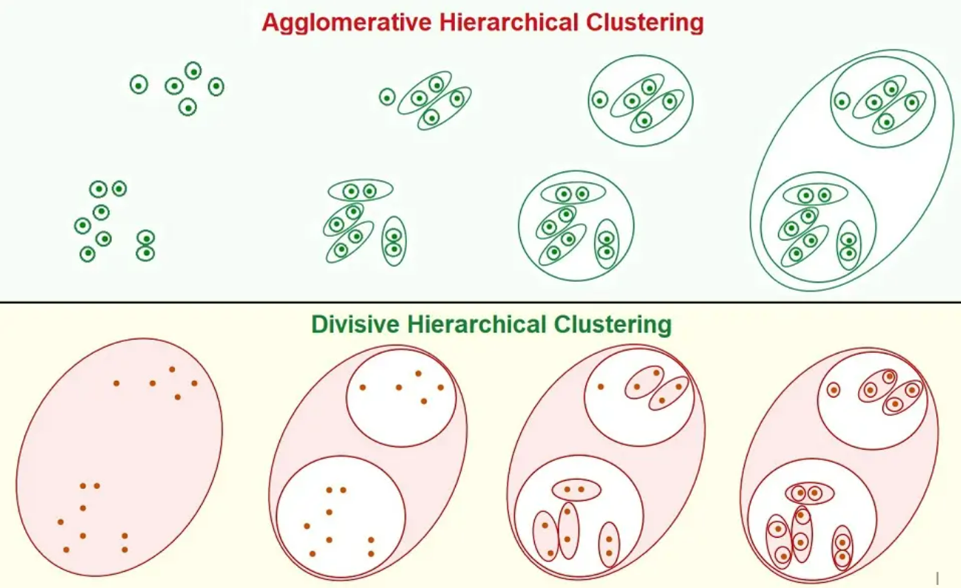
Diagram for Agglomerative and Divisive Cluster

Slide 10
Advantages:
No Need to Predefine K: Unlike K-means, you don't need to specify the number of clusters in advance.
Dendrogram Visualization: Provides a clear visual representation of the clustering structure, allowing for easy interpretation of data relationships.
Versatile: Works well with various types of distance metrics and can handle different cluster shapes and sizes.
Disadvantages:
Computationally Expensive: Especially with large datasets, as the complexity increases with the number of data points.
Sensitivity to Noise: Can be sensitive to outliers, which might affect the formation of clusters.
Inflexibility: Once a decision is made to merge or split clusters, it cannot be undone.

Slide 11
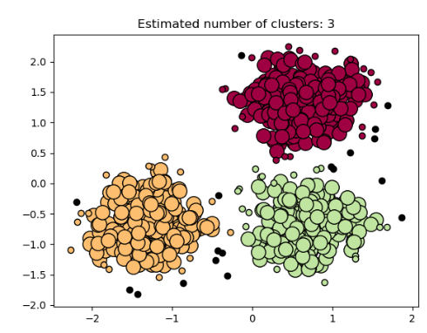
DBSCAN:
Definition: (Density-Based Spatial Clustering of Applications with Noise.)
DBSCAN is a clustering algorithm that groups together points that are close to each other and labels points that are far away as outliers.
Basic Concept:
DBSCAN works by finding areas where points are densely packed and forms clusters from these dense regions. Unlike other algorithms, it doesn't require to know the number of clusters in advance.
Working Principle:
Dense Regions: Points that have many neighbors within a certain distance are grouped together.
Outliers: Points that don't have enough nearby neighbors are marked as outliers. Outliers is otherwise called as Noise Points
Clusters: The algorithm continues to group dense regions into clusters until all points are either part of a cluster or marked as outliers.

Slide 12
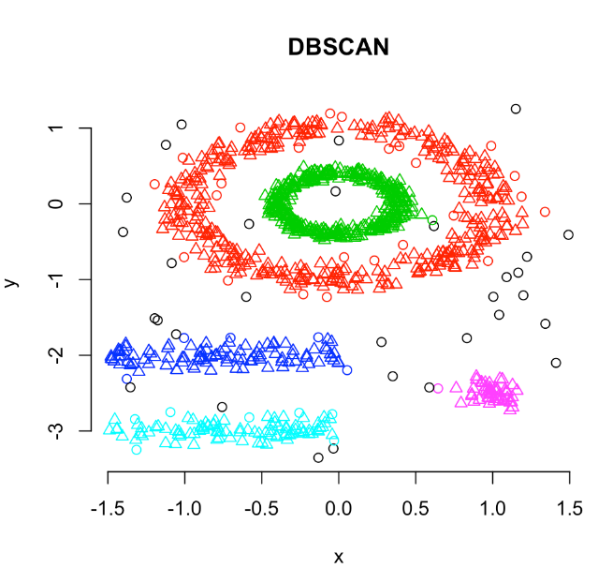
Advantages:
No Need for Predefined Clusters: You don't have to know the number of clusters beforehand.
Handles Outliers Well: It automatically identifies and excludes outliers.
Works with Any Shape: It can find clusters of any shape, not just round ones.
Disadvantages:
Parameter Sensitivity: The outcome depends on the choice of distance and neighbor thresholds.
Struggles with Varying Densities: It may not perform well if clusters have different densities.

Slide 13
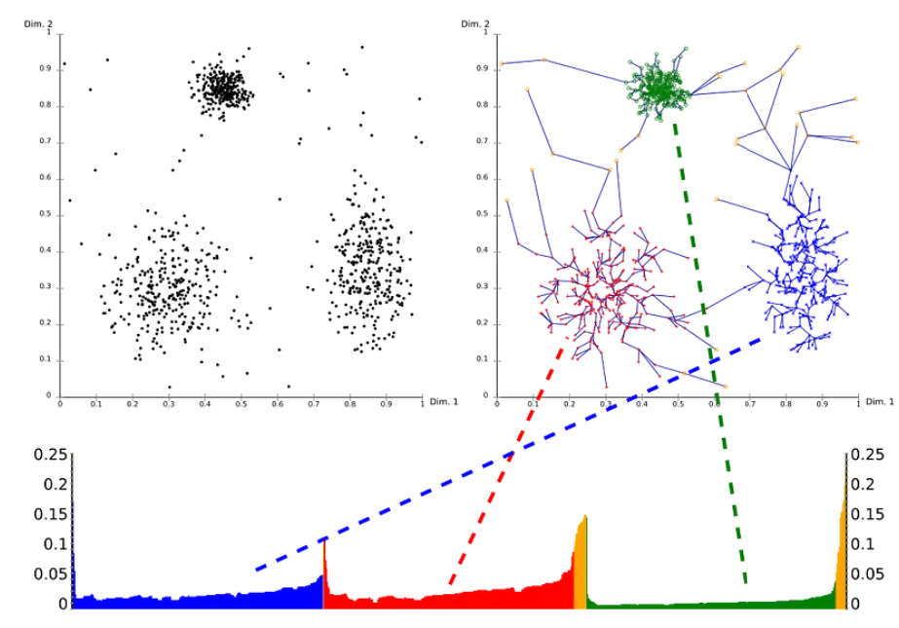
OPTICS
Definition:
Ordering Points To Identify the Clustering Structure is a clustering algorithm that orders data points to reveal cluster structure and hierarchical relationships.
Concept:
OPTICS extends DBSCAN by creating an ordering of points based on reachability distances, which helps identify clusters of varying densities.
Working Principle
Reachability Distance: Calculate for each point relative to its neighbors.
Ordering Points: Arrange based on reachability distances to reflect clustering structure.
Cluster Extraction: Analyze the reachability plot to identify clusters by finding valleys (lower distances).

Slide 14
Advantages
Handles Varying Densities: Can identify clusters of different densities and sizes.
No Need to Predefine Clusters: No need to specify the number of clusters.
Hierarchical Clustering: Provides insights into hierarchical structure of clusters.
Disadvantages
Computational Complexity: May be intensive for large datasets.
Parameter Sensitivity: Performance depends on radius and minimum points parameters.
Complex Output: The reachability plot can be difficult to interpret and requires additional steps

Slide 15
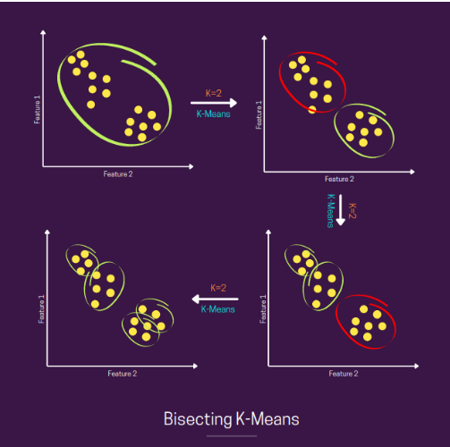
BisectingKMeans
Definition
Bisecting K-Means is an enhanced version of K-Means that improves clustering by recursively splitting clusters.
Basic Concept
Recursive Splitting: Start with one big cluster and repeatedly divide it into two smaller clusters.
K-Means Use: Applies K-Means to split the chosen cluster at each step.
Working Principle
Start: Begin with all data in one cluster.
Split: Use K-Means to divide this cluster into two.
Repeat: Continue splitting clusters until the desired number of clusters is reached.

Slide 16
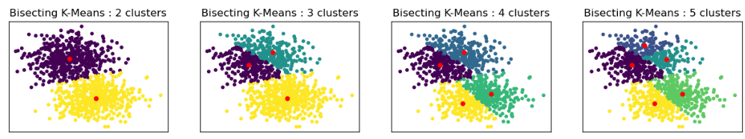
Advantages
Better Results: Often yields more accurate clusters than basic K-Means.
Flexibility: Handles different shapes and sizes of clusters better.
Hierarchical Structure: Creates a hierarchy of clusters, useful for analysis.
Disadvantages
More Computationally Intensive: Requires more computing power than basic K-Means.
Sensitive to Parameters: Performance depends on the number of clusters and initial choices.
Local Optima: Can still get stuck in suboptimal cluster configurations.

Slide 17
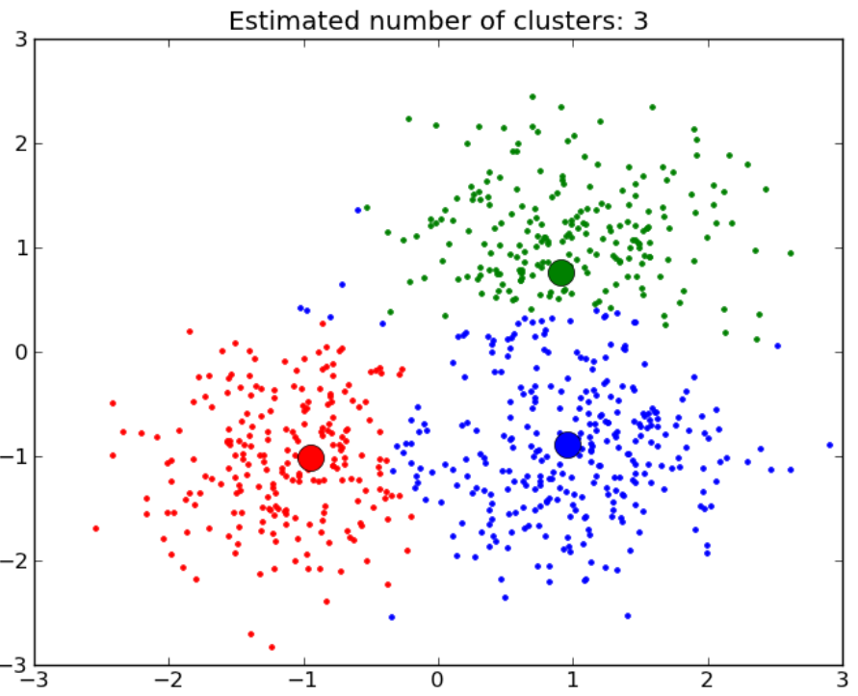
Mean Shift
Definition
Mean Shift is a clustering algorithm that finds clusters by shifting data points towards the mean of their neighborhood.
Basic Concept
Center Finding: Identifies clusters by moving data points towards the average position of points in their vicinity.
Working Principle
Initialize: Start with data points and a window (or bandwidth) around each point.
Shift Points: Move each point towards the average position of points within its window.
Repeat: Continue shifting until points converge to stable positions.
Form Clusters: Points that converge to the same position are considered to be in the same cluster.

Slide 18
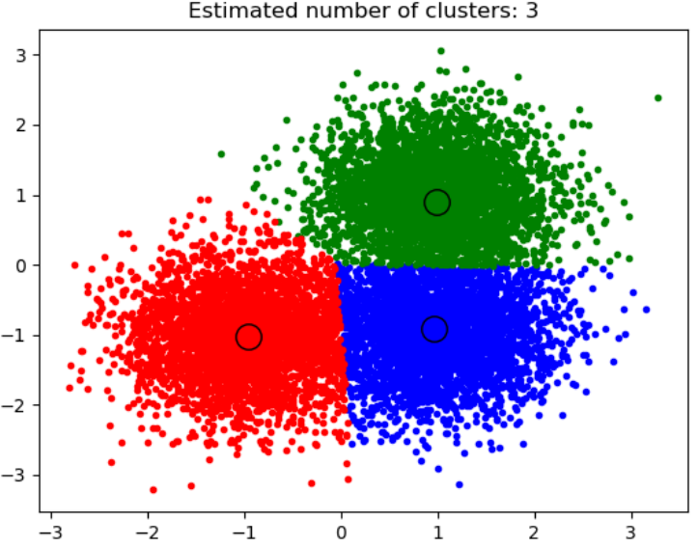
Advantages
No Need to Predefine Clusters: Automatically determines the number of clusters.
Handles Arbitrary Shapes: Can find clusters of different shapes and sizes.
Robust to Outliers: Less sensitive to outliers compared to some other algorithms.
Disadvantages
Computationally Intensive: Can be slow, especially with large datasets.
Parameter Sensitivity: Performance depends on the choice of the bandwidth parameter.
Not Suitable for High Dimensions: May struggle with very high-dimensional data.

Slide 19
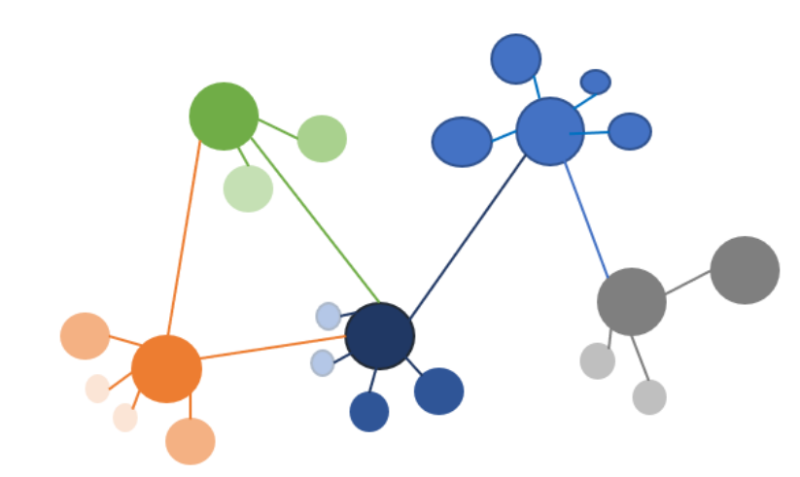
Spectral clustering
Definition
Spectral Clustering is a clustering technique that uses the eigenvalues of a similar matrix to reduce dimensions and find clusters.
Basic Concept
Graph-Based: Treats data as a graph and uses its spectrum (eigenvalues of the Laplacian matrix) to identify clusters.
Working Principle
Construct Similarity Matrix: Create a matrix that measures how similar data points are to each other.
Compute Laplacian: Calculate the Laplacian matrix from the similarity matrix.
Find Eigenvalues and Eigenvectors: Use eigenvectors of the Laplacian matrix to reduce the dimensionality.
Clustering: Apply a clustering algorithm (like K-Means) to the reduced-dimensional data.

Slide 20
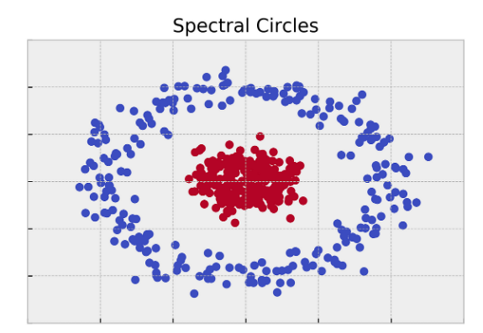
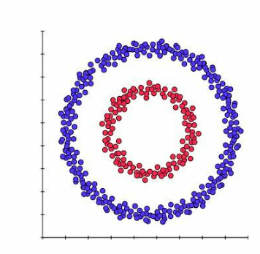

Advantages
Effective for Complex Shapes: Can identify clusters with complex shapes.
Handles Non-Convex Clusters: Works well with non-convex clusters where other methods might fail.
Flexibility: Can use different similarity measures.
Disadvantages
Computationally Intensive: Requires eigenvalue computation, which can be slow for large datasets.
Parameter Sensitivity: Performance depends on the choice of similarity measure and the number of clusters.
Scaling Issues: May not scale well with very large datasets.

Slide 21
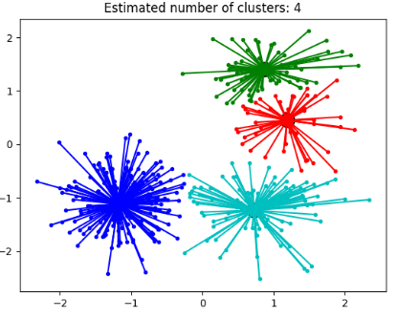
Affinity propagation
Definition
Affinity Propagation is a clustering algorithm that identifies clusters by sending messages between data points to find exemplars (representative points).
Basic Concept
Message Passing: Uses a message-passing approach to determine which data points should be exemplars and form clusters.
Working Principle
Similarity Matrix: Create a matrix showing how similar each data point is to others.
Message Exchange: Data points send messages to each other to express their suitability as exemplars.
Update Responsibilities: Update the responsibilities (how well a point fits as an exemplar) and availabilities (how well a point is suited to be an exemplar).
Convergence: Iteratively update these messages until the algorithm converges and clusters are formed.

Slide 22
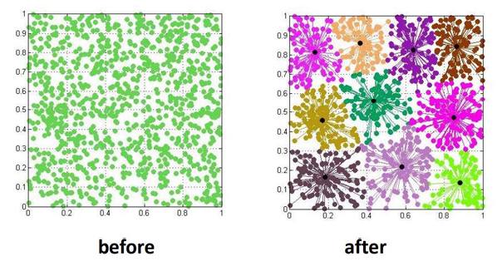
Advantages
No Need to Predefine Clusters: Automatically determines the number of clusters.
Flexibility: Can handle clusters of different shapes and sizes.
Effective for Large Datasets: Can work well with larger datasets compared to some other algorithms.
Disadvantages
Computationally Intensive: Can be slow for very large datasets due to the number of message updates.
Parameter Sensitivity: Performance depends on the choice of similarity measure and preference parameters.
Memory Usage: Requires storage of similarity and message matrices, which can be large.

Slide 23
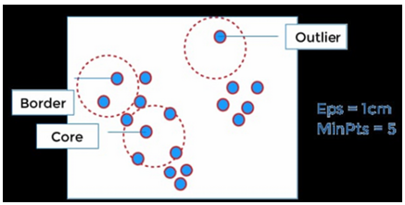
HDBSCAN
Definition
HDBSCAN (Hierarchical Density-Based Spatial Clustering of Applications with Noise) is a clustering algorithm that identifies clusters based on density and hierarchical clustering.
Basic Concept
Density-Based: Finds clusters by looking for areas of high density and can handle varying densities.
Hierarchical: Builds a hierarchy of clusters, which can be used to extract clusters at different levels of granularity.
Working Principle
Build a Hierarchy: Construct a hierarchy of clusters based on density.
Extract Clusters: Use a minimum cluster size and density threshold to extract the final clusters from the hierarchy.
Handle Noise: Identify and exclude outliers or noise points.

Slide 24
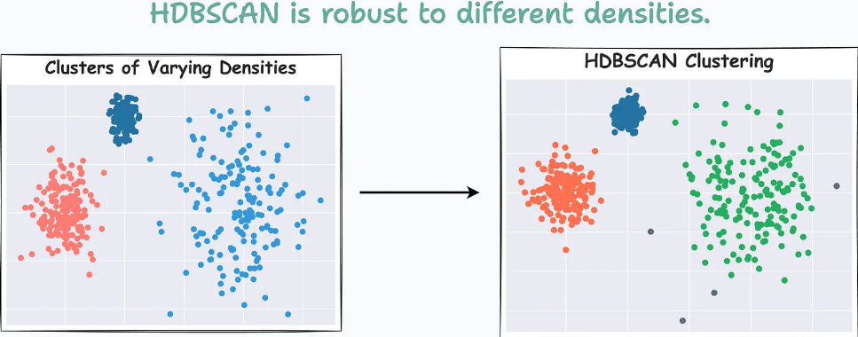
Advantages
Handles Varying Densities: Can find clusters with different densities.
No Need to Predefine Clusters: Automatically determines the number of clusters.
Robust to Noise: Effectively identifies and excludes outliers.
Disadvantages
Computational Complexity: Can be slower for very large datasets due to hierarchical computation.
Parameter Sensitivity: Performance depends on the choice of parameters like minimum cluster size and minimum samples.
Complexity in Interpretation: The hierarchical nature can make the results complex to interpret.

Slide 25
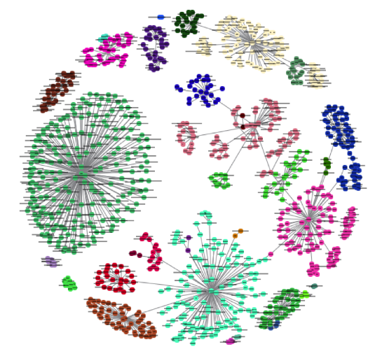
Birch clustering
Definition
BIRCH (Balanced Iterative Reducing and Clustering using Hierarchies) is a clustering algorithm designed for large datasets by using a tree-based approach to efficiently manage and cluster the data.
Basic Concept
Hierarchical Clustering: Uses a tree structure to summarize and cluster data incrementally.
Scalable: Designed to handle large datasets efficiently.
Working Principle
Build a CF Tree: Create a Clustering Feature (CF) Tree that summarizes data points in a hierarchical manner.
Insert Points: Insert data points into the CF Tree to build a compact representation of the data.
Cluster Extraction: Use a clustering algorithm (e.g., K-Means) on the leaf nodes of the CF Tree to extract final clusters.

Slide 26
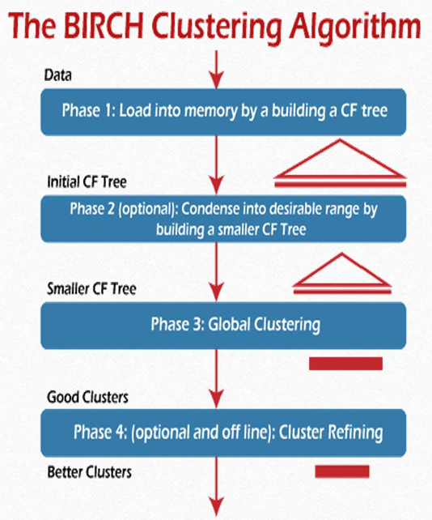
Advantages
Scalable: Handles large datasets efficiently.
Incremental: Can update the model as new data arrives without reprocessing the entire dataset.
Memory Efficient: Uses a compact tree structure to represent data.
Disadvantages
Parameter Sensitivity: Requires careful tuning of parameters like the branching factor and thresholds.
Cluster Shape Limitations: May not handle very irregular or complex cluster shapes as effectively as some other algorithms.
Initial Assumptions: Assumes that clusters are somewhat spherical and evenly distributed.

Slide 27
THANK YOU

